Slide 1
Financial Information Systems Final Project
Akhil Gupta
Asmita Kumar
Kunal Sharma
Siddharth Dixit
Trisha Chandra

Slide 2
Introduction
$ 50 K for investment among Stocks, Bonds and Options
Optimize Returns keeping Moderate Risk
Portfolio | Return | Risk
Bonds | Low | Low
Asset Portfolio | High | Moderate
Options | High | Moderate

Slide 3
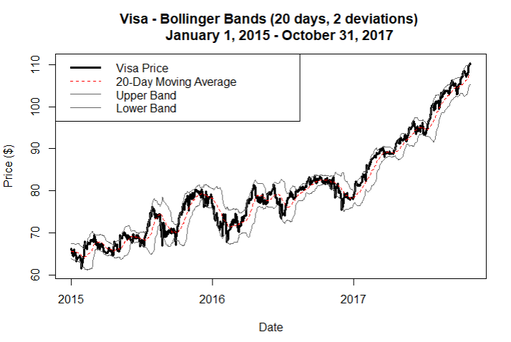
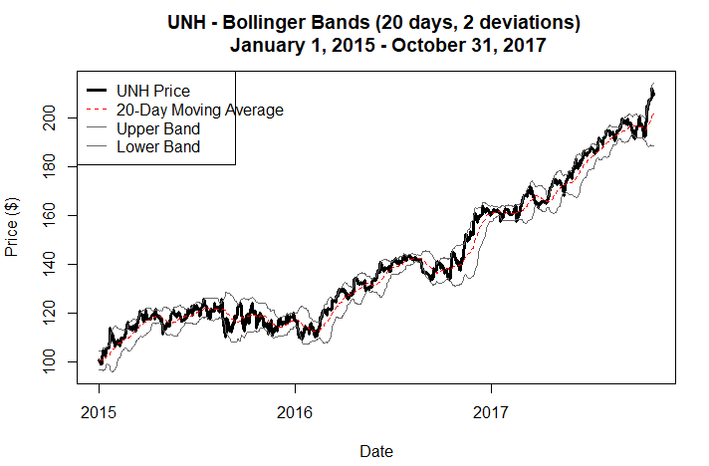
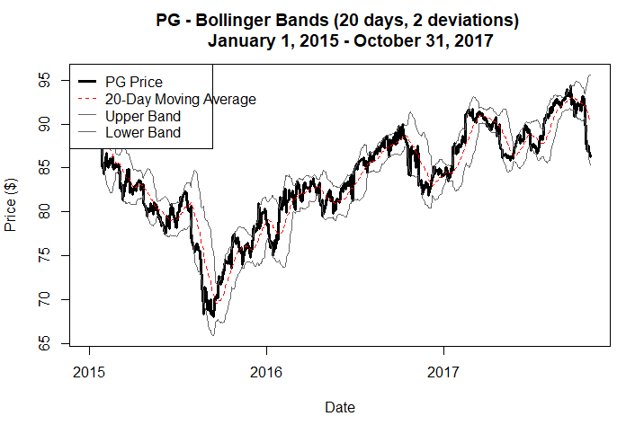
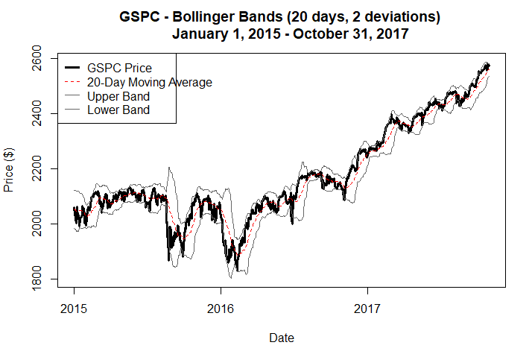
Technical Analysis
Bollinger bands for volatility
Notes:
PV01:price of a bond if the required yield changes by .01%

Slide 4
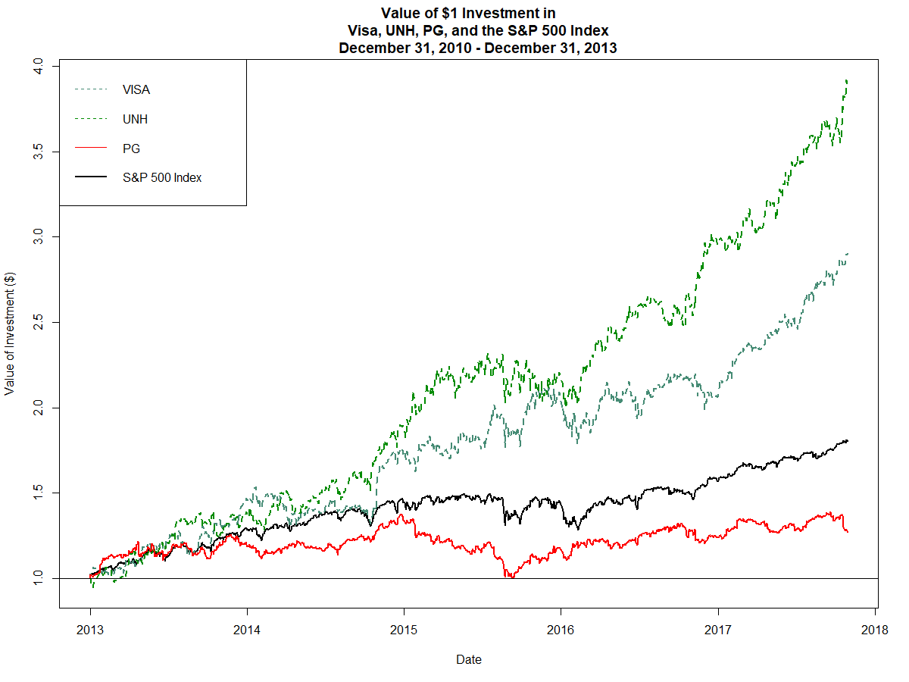
CAPITAL GAINS
Stocks for VISA and UNH have very high returns for a period of 5 years
Visa and UNH outperformed market index and had very high returns over 5 years
PG did not perform too well compared to market index
PG’s stock prices have fallen and are expected to rise soon

Slide 5
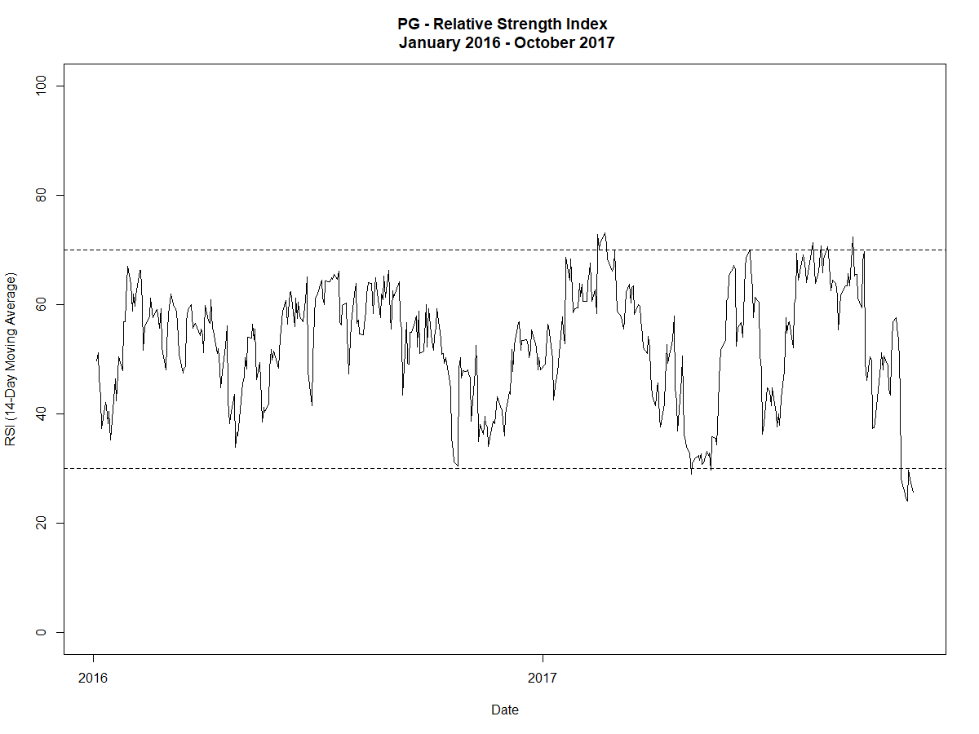
Relative Strength Index for PG
RSI shows that PG stocks were oversold recently
Very high chance of PG stocks to bounce back
Good choice for investing in call options

Slide 6
Selection of Stocks
Stock | Visa | United Health Group | Procter and Gamble | S&P 500
Beta Index | 1.05 | 0.54 | 0.48 | 1
Standard Deviation | ± 1.27 | ± 1.26 | ± 0.88 | ± 0.75
Variance | 1.628 | 1.59 | 0.78 | 0.56
Volatility | Moderate | Moderate | Moderate | Low
Based on our analysis, we expect our portfolio to give high returns compared to bonds and options
We are going to invest $ 40, 000 in our portfolio containing Visa stocks, UNH stocks and S&P 500 exchange traded funds or iShares.
We will invest $ 5000 in options for PG and $ 5000 in bonds
Notes:
PV01:price of a bond if the required yield changes by .01%

Slide 7
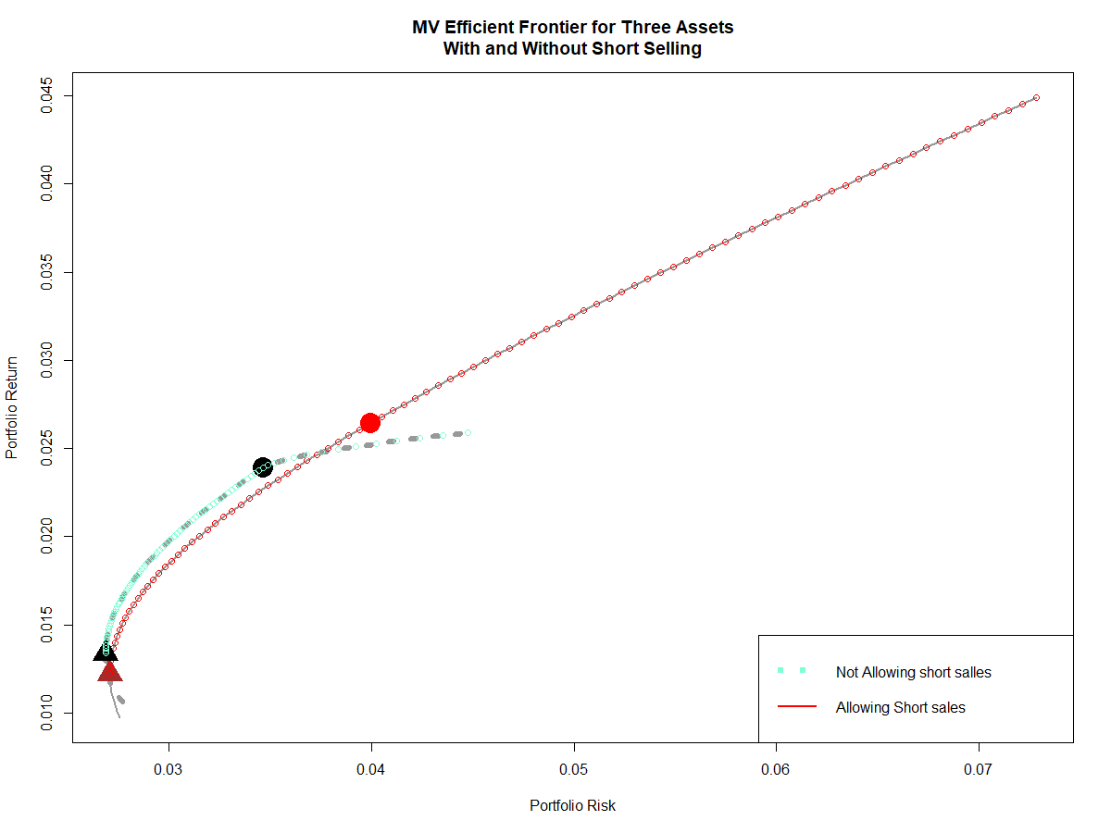
Risk Return Trade-off for portfolio
Short selling is borrowing stocks without owning them and selling them immediately and buy later at lower price.
Buyer earns profit on difference without actually owning the stocks.
High risk and high returns for portfolio with short-selling
Small increase in returns for much greater risk

Slide 8
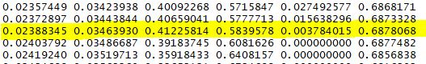
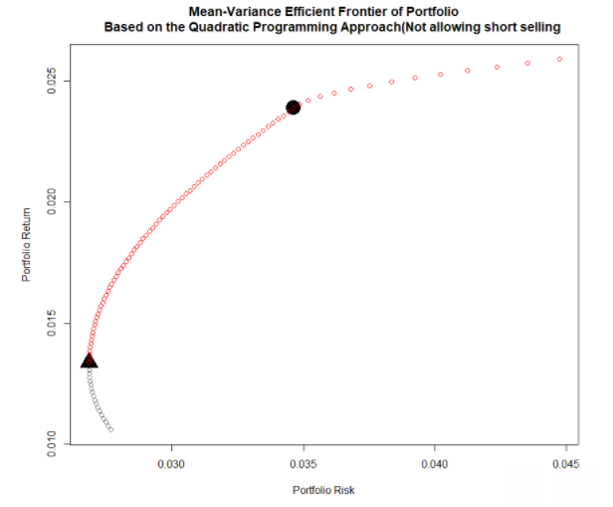
Risk Return Trade-off
Sharpe ratio and Tangency Portfolio
Return : 2.389%
Risk: ± 0.034
Sharpe Ratio: 0.6878
Stock | Visa | United Health Group | S&P 500
Weight | 41.22% | 58.39% | 0.39%
Notes:
PV01:price of a bond if the required yield changes by .01%

Slide 9
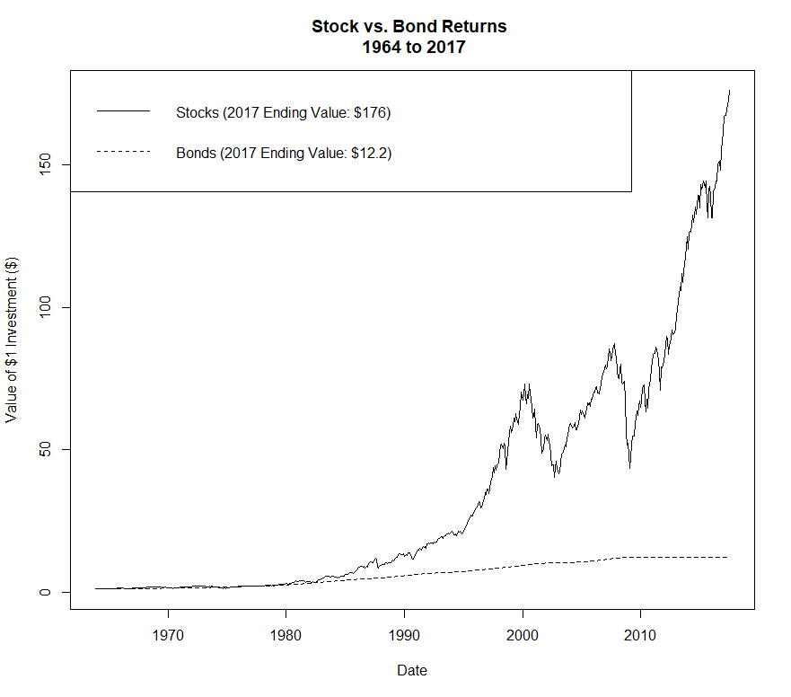
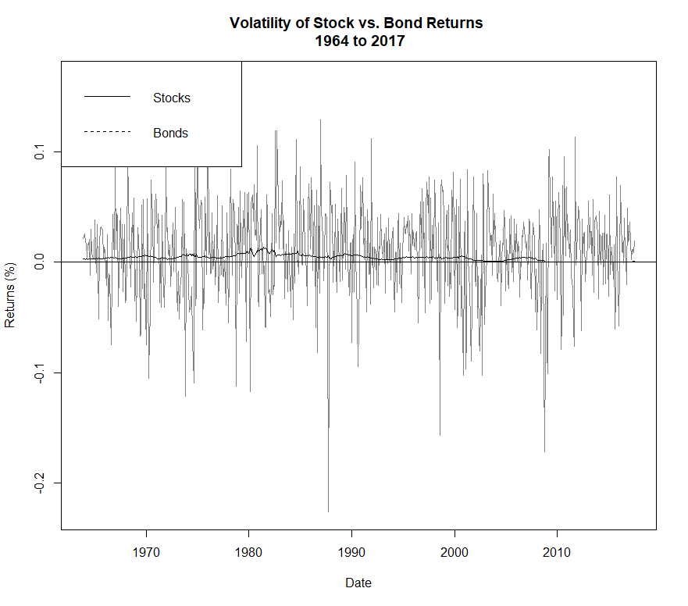
Stocks vs Bonds

Slide 10
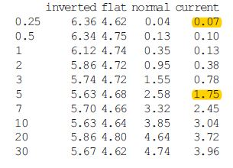
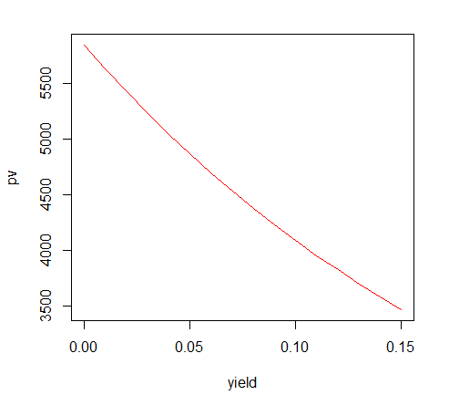
Investment in Bonds - US treasury bonds
Return for 5 years : $ 606.04
Return for 3 months : $ 42.80
Best Performing Bond Market Segments, 4 Years
Emerging Markets 10.70%
High Yield 10.36%
Investment-Grade Corporates (all maturities) 10.57%
Long-Term Corporate Bonds 8.69%
Long-Term Government Bonds 6.99%
Barclays U.S. Aggregate Bond Index 4.12%
S&P 500 Index 15.70%
Risk:
Value of a one dollar or one basis point annuity (PV01): 0.00027
Notes:
PV01:price of a bond if the required yield changes by .01%

Slide 11
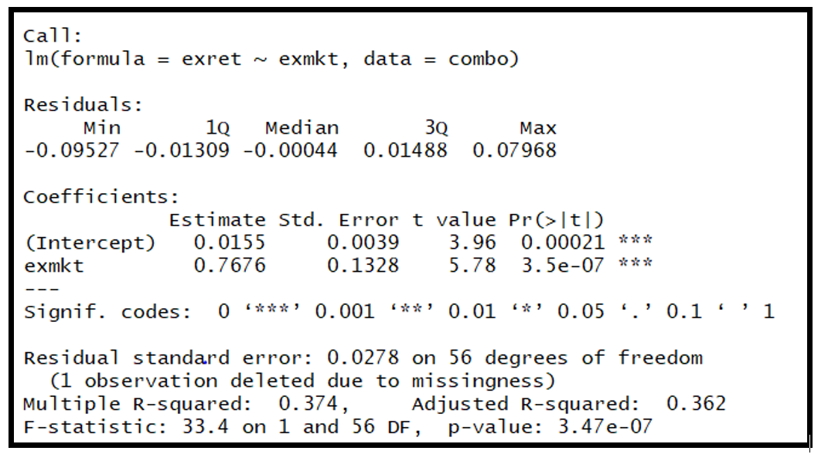
Capital Asset Pricing model
Notes:
PV01:price of a bond if the required yield changes by .01%

Slide 12
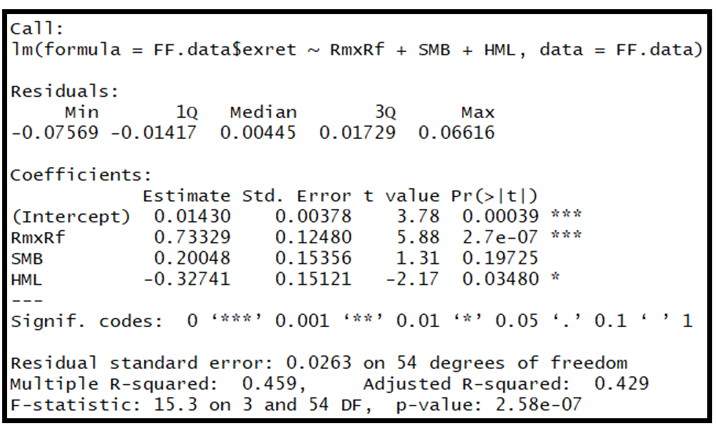
Fama-french: three factor model
Notes:
PV01:price of a bond if the required yield changes by .01%

Slide 13
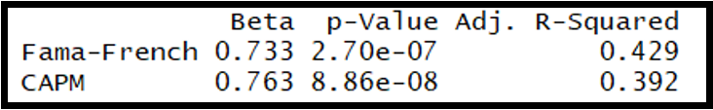
Comparison of Models
FF is better than CAPM since it takes more factors into consideration.
Additional factors are statistically significant.
The Adjusted R-squared is better for Fama-French which shows we are not penalized for adding additional factors.
Beta is lower for Fama-French
Notes:
PV01:price of a bond if the required yield changes by .01%

Slide 14
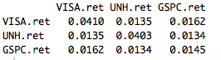
Variance Co-variance matrix
Portfolio Annualized Standard deviation is 16.51 %
When we add assets that are not perfectly correlated with the securities in our portfolio,# the overall risk of the portfolio decreases.
Notes:
PV01:price of a bond if the required yield changes by .01%

Slide 15
Value at Risk
# 1% Significance level VaR : $ 1000
# 5% Significance level VaR : $ 628
#Historical Expected Shortfall: $ 4644
# 5% 1-Day Historical ES: $ 3366
Notes:
PV01:price of a bond if the required yield changes by .01%

Slide 16
1.628
Notes:
PV01:price of a bond if the required yield changes by .01%

Slide 17
Options
Proctor & Gamble
Value Date: 11th November ‘17
Expiry Date: 16th February ’18
Historical Volatility from 2013-2017: 5.371
Black Scholes Output:
Current Stock Price: 90.37
Options Pricing Model | $90 | $95
Call | $74.17 | $73.72
Put | $73.51 | $78.05
Notes:
PV01:price of a bond if the required yield changes by .01%

Slide 18
Options
Proctor & Gamble
Value Date: 11th November ‘17
Expiry Date: 16th February ’18
Historical Volatility from 2013-2017: 5.371
Black Scholes Output:
Current Stock Price: 90.37
Options Pricing Model | $90 | $95
Call | $74.17 | $73.72
Put | $73.51 | $78.05
Notes:
PV01:price of a bond if the required yield changes by .01%

Slide 19
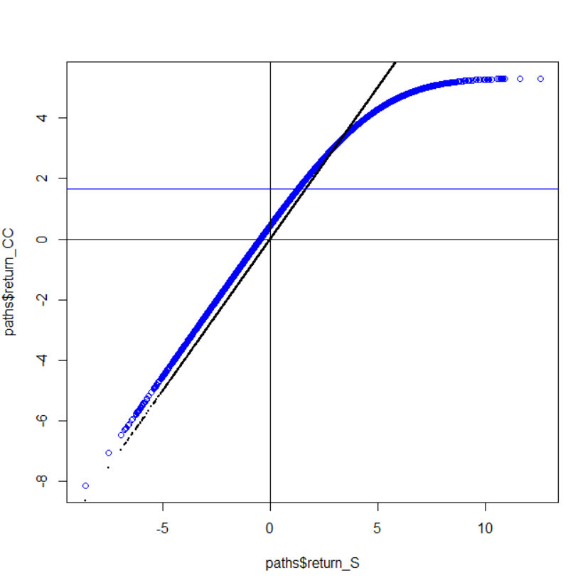
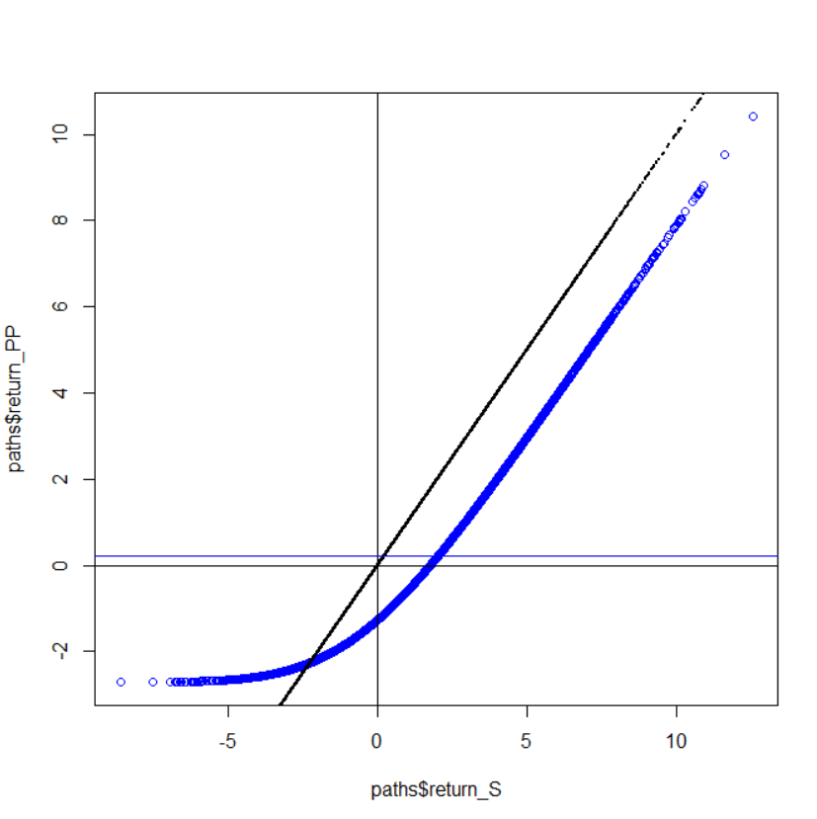
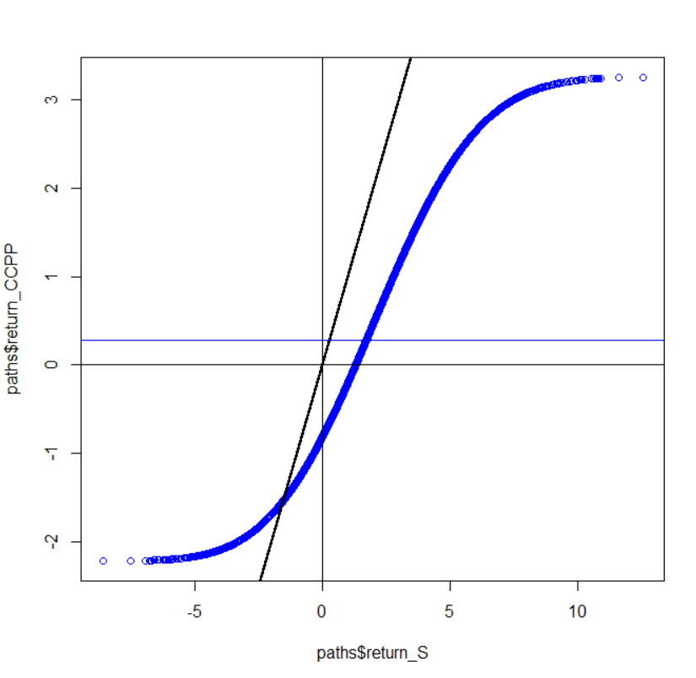
Options Simulation: 3 Months From Now
1. Covered Call
2. Protective Put
3. CC + PP
1.67% Return, $83.46 Profit
0.23% Return
0.277% Return
Notes:
PV01:price of a bond if the required yield changes by .01%

Slide 20
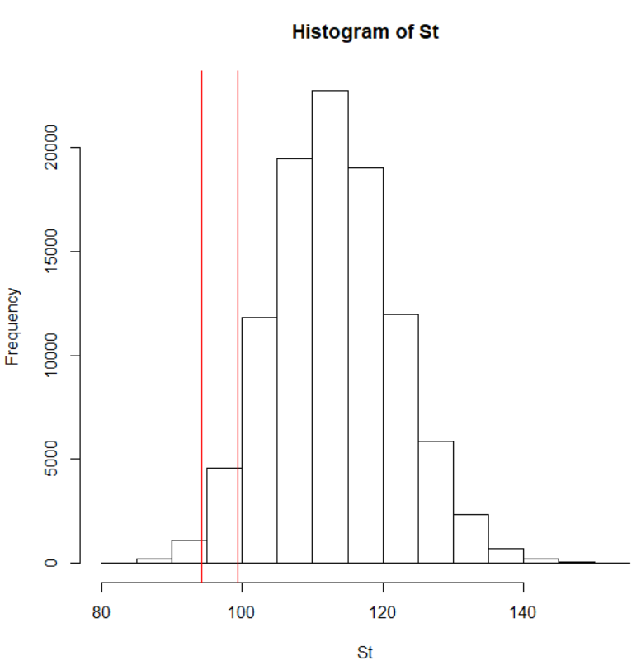
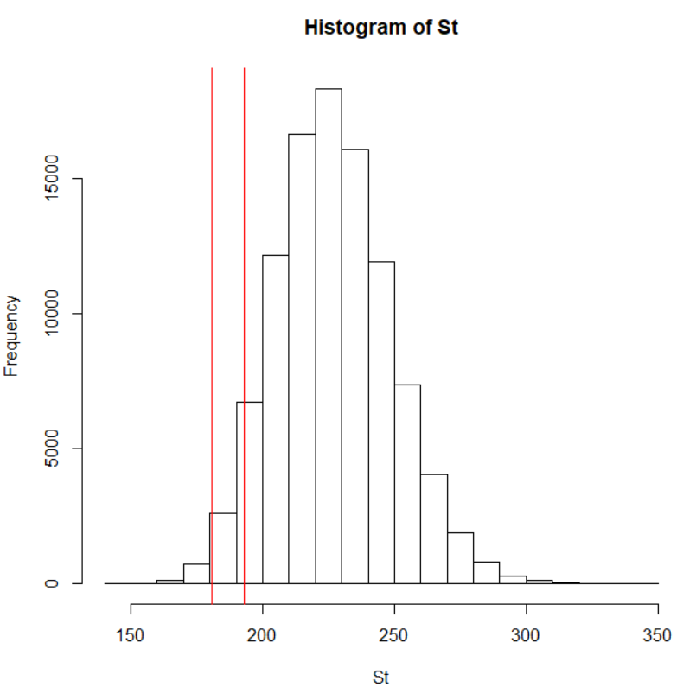
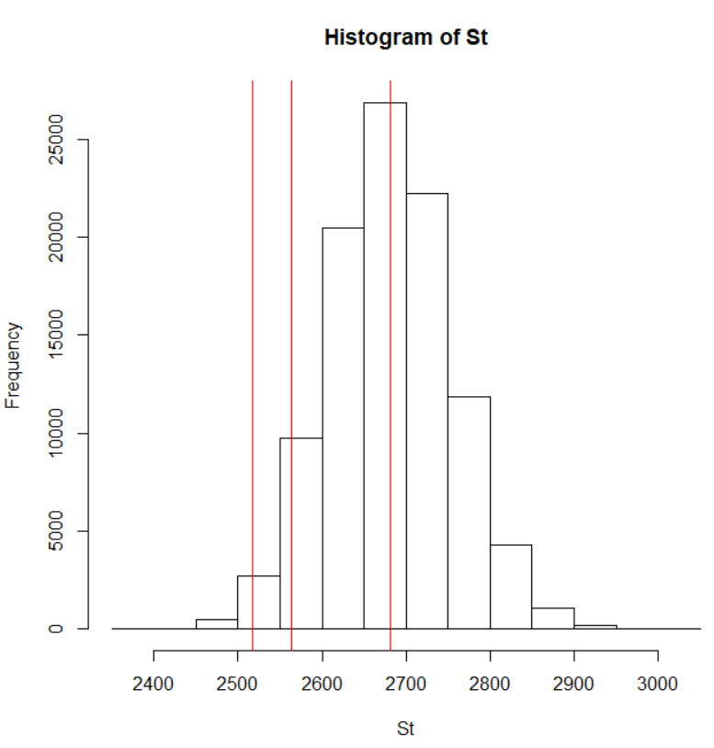
Stocks Simulation : Things Look Good!
1% and 5% VARs for Visa, United Healthcare and S&P
Visa | VAR
1%ile | 94.18
5%ile | 99.37
UNH | VAR
1%ile | 180.87
5%ile | 193.03
S&P 500 | VAR
1%ile | 2517.9
5%ile | 2564.75
Notes:
PV01:price of a bond if the required yield changes by .01%

Slide 21
Final Return
 | Portfolio |  |  | Bonds | Options
 | Visa | United Health Group | S&P 500 | Total MTNS | P&G
Weights in % | 32.98% | 46.71% | 0.31% | 10% | 10% | 100%
Weights in amount | $ 16,488 | $ 23,356 | $ 156 | $ 5,000 | $ 5,000 | $ 50,000
Historical Return for 5 years | 267.17% |  |  | 12.12%
Historical VaR at 1% | $1,000
Historical VaR at 5% | $628
Historical ES at 1% | $4,644
Historical ES at 5% | $3,366
Simulated Return after 3 months | 2.46% |  |  | 0.85 % | 1.67 %
Final Return | $ 984 |  |  | $ 42.80 | $ 83.5 | $1,120.5
Notes:
PV01:price of a bond if the required yield changes by .01%

Slide 22
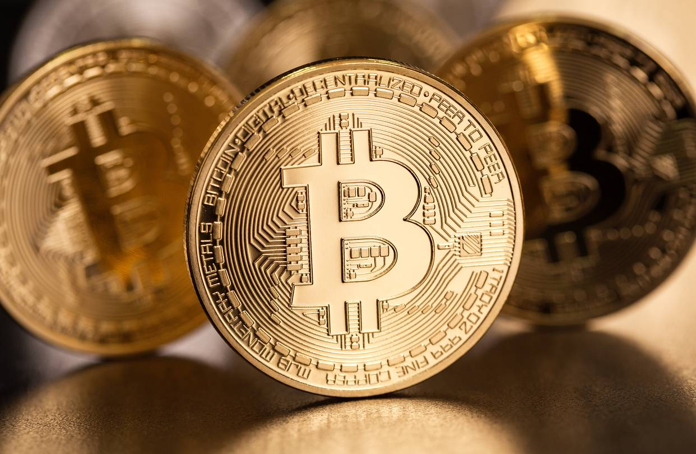

Recommendation
Bonds have much better returns if invested for a long term. We would suggest investing in bonds for a period of 10 years.
We would suggest not selling the call options on expiry if PG stock price falls
Invest for short term, intermediate term and long term for best returns.
Keep changing and Investing in different companies and assets depending upon the market scenario.
Notes:
PV01:price of a bond if the required yield changes by .01%

Slide 23
Thank You.

